Slide 1
SUPPLY CHAIN MANAGEMENT

Slide 2
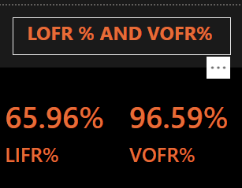


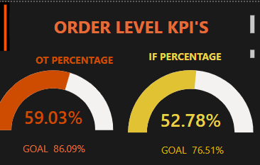

65.96% of the total order lines were shipped in full without any shortages or partial deliveries.
96.59% of the total ordered quantity was successfully delivered to the customers.
458K(3.52%) orders have
Been undelivered out of
Total orders (13 M)
On Time Percentage and In full
Percentage are significantly lower than the targeted OT % and IF% .Only 59.03% of total orders are delivered on time which shows poor delivering capabilities.

Slide 3
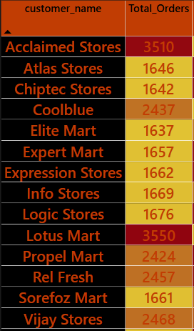
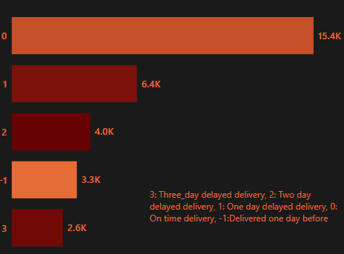
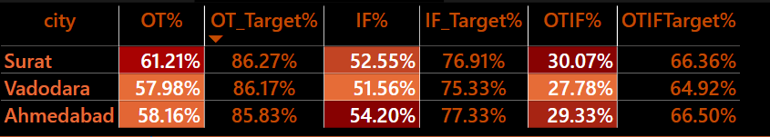
13K orders have been delivered late from the agreed delivery late which is 40.63% of the total orders(32k)
Acclaimed Stores ,Lotus Mart, Vijay Stores, Rel Fresh, Coolblue constitutes 45.07% of total orders and seems to be the key customers
Vadodara has the lowest OTIF%(27.78%) among all cities which is significantly lower than the targeted percentage.

